Slide 1
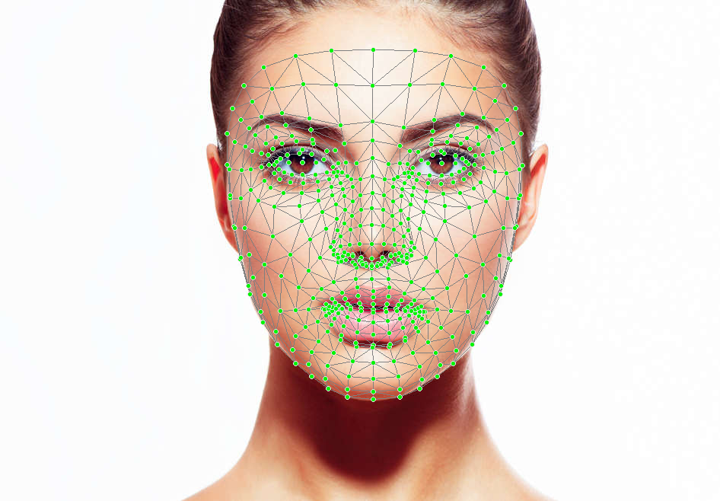
AI Cheating Detection Using Face Mesh
Final Project Presentation
Prepared by: Zahraa Mohammed Sabah
Class: GA – Morning

Slide 2

Introduction
• This project detects cheating during online exams.
• Uses MediaPipe Face Mesh + Logistic Regression.
• Detects when a student looks away from the screen.

Slide 3

Objective
• Build a lightweight real‑time monitoring system.
• Detect suspicious head movement.
• Avoid complex deep‑learning models.

Slide 4
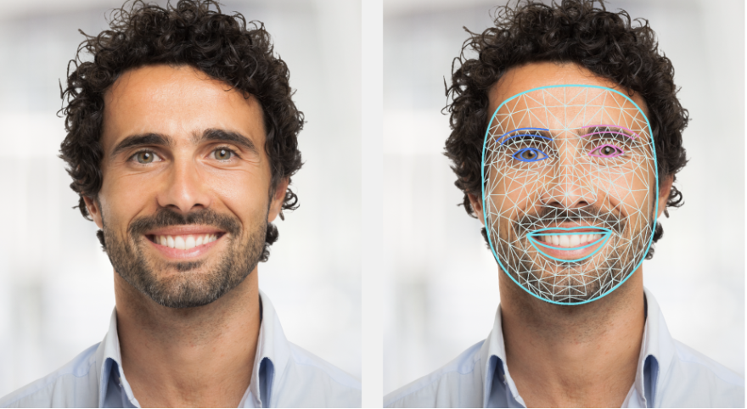
Methodology
• MediaPipe Face Mesh provides 468 facial landmarks.
• Used 3 points: Left Eye (33), Right Eye (263), Nose (1).
• Calculate ratios to detect head movement.
• Logistic Regression for classification.

Slide 5
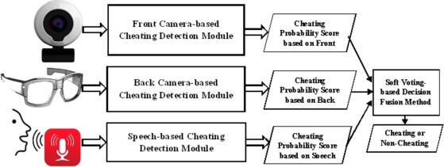
Dataset & Training
• Small custom dataset created manually.
• Ratios close to 1.0 = normal.
• Extreme ratios = looking sideways.
• Model accuracy printed during execution.
Accuracy: 57%

Slide 6
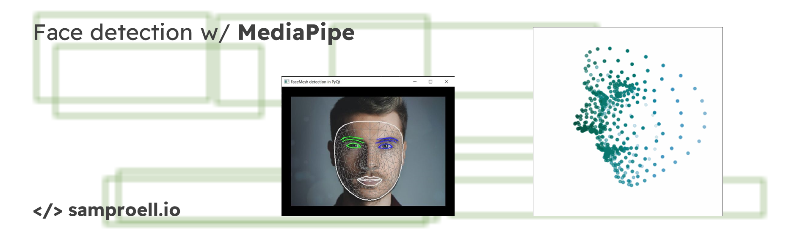
System Implementation
• OpenCV captures video.
• MediaPipe extracts face landmarks.
• Real‑time ratio calculation.
• Alerts appear when cheating is detected.

Slide 7
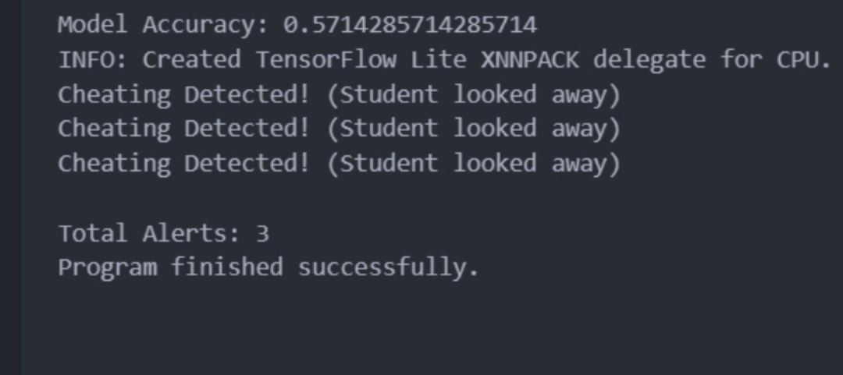
Results
• Detects when student looks away from the screen.
• Accuracy measured on training data.
• Face mesh and dots displayed in real time.

Slide 8

Conclusion
• Simple ML model can detect cheating.
• Fast, efficient, and works in real time.
• Suitable for exam monitoring systems.

Slide 9

Future Improvements
• Add blink detection or phone detection.
• Use more landmarks for better accuracy.
• Upgrade to deep learning.
• Collect a larger dataset.

